Slide 1
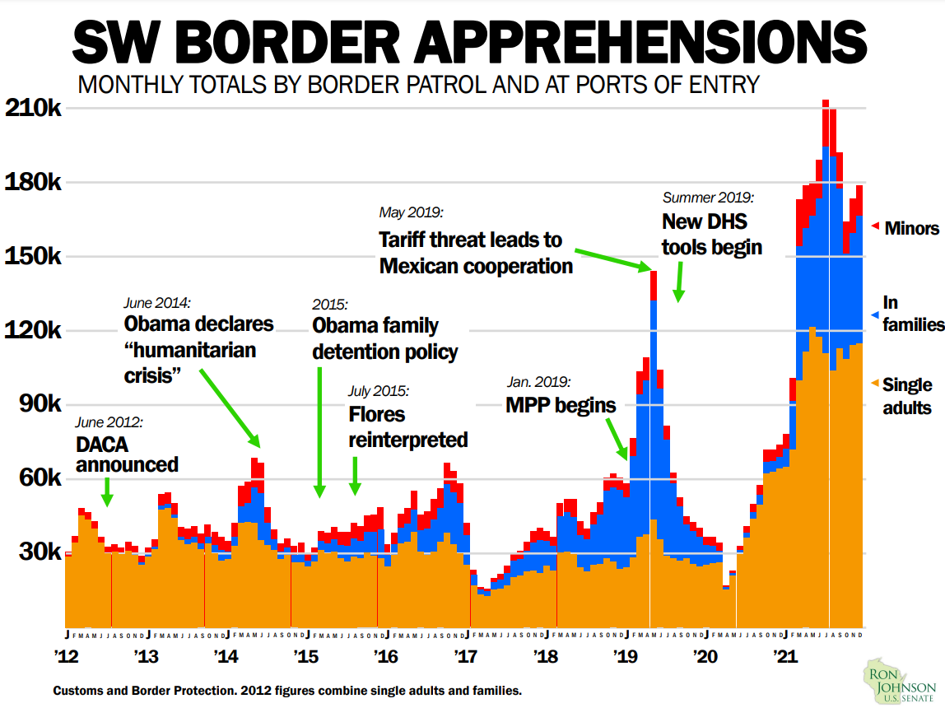

Slide 2
Border Patrol Arrests of Aliens with Criminal Convictions by Type
 | FY16 | FY17 | FY18 | FY19 | FY20 | FY21 | FY22TD
Assault, battery, domestic violence | 1,007 | 692 | 524 | 299 | 208 | 1,178 | 339
Burglary, robbery, larceny, theft, fraud | 825 | 595 | 347 | 184 | 143 | 825 | 260
Driving under the influence | 2,458 | 1,596 | 1,113 | 614 | 364 | 1,629 | 383
Homicide, manslaughter | 8 | 3 | 3 | 2 | 3 | 60 | 22
Illegal drug possession, trafficking | 1,797 | 1,249 | 871 | 449 | 386 | 2,138 | 628
Illegal entry, re-entry | 7,060 | 4,502 | 3,920 | 2,663 | 1,261 | 6,160 | 1,718
Illegal weapons possession, transport, trafficking | 237 | 173 | 106 | 66 | 49 | 336 | 90
Sexual offenses | 155 | 137 | 80 | 58 | 156 | 488 | 99
Other * | 2,544 | 1,851 | 1,364 | 814 | 580 | 2,691 | 821
Fiscal Year 2022 runs October 01, 2021- September 30, 2022.
*“Other” includes any conviction not included in the categories above.

Slide 3
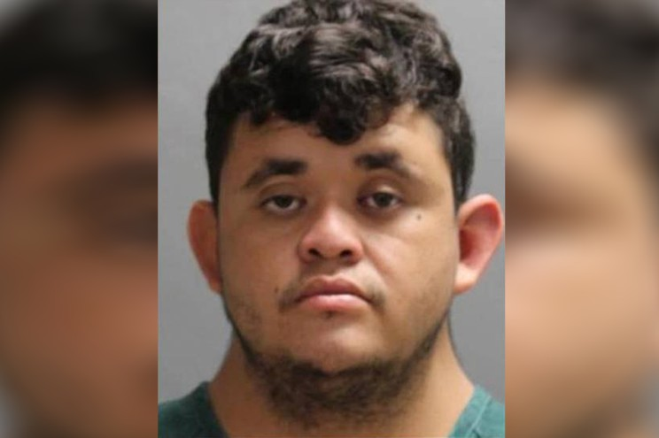
Illegal immigrant who posed as teen arraigned in Florida murder
By Jorge Fitz-Gibbon
November 4, 2021

Slide 4
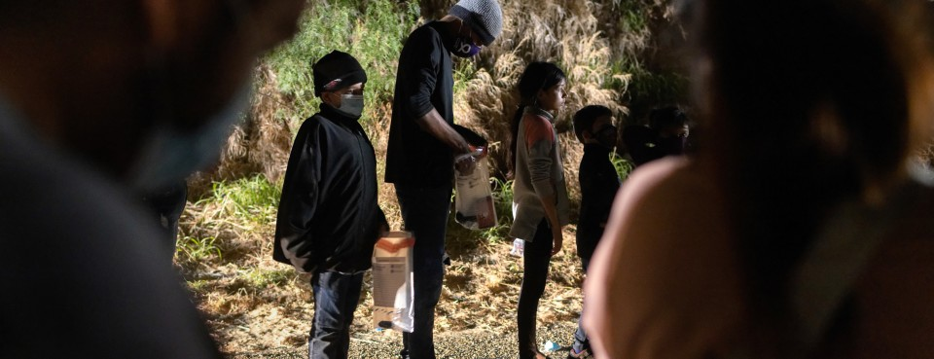
U.S. Probes Trafficking of Teen Migrants for Poultry-Plant Work
EXCLUSIVE
Aug. 19, 2021, 9:46 AM; Updated: Aug. 19, 2021, 5:36 PM
DOJ investigates alleged widespread labor trafficking
Comes amid increase of unaccompanied minors at border

Slide 5
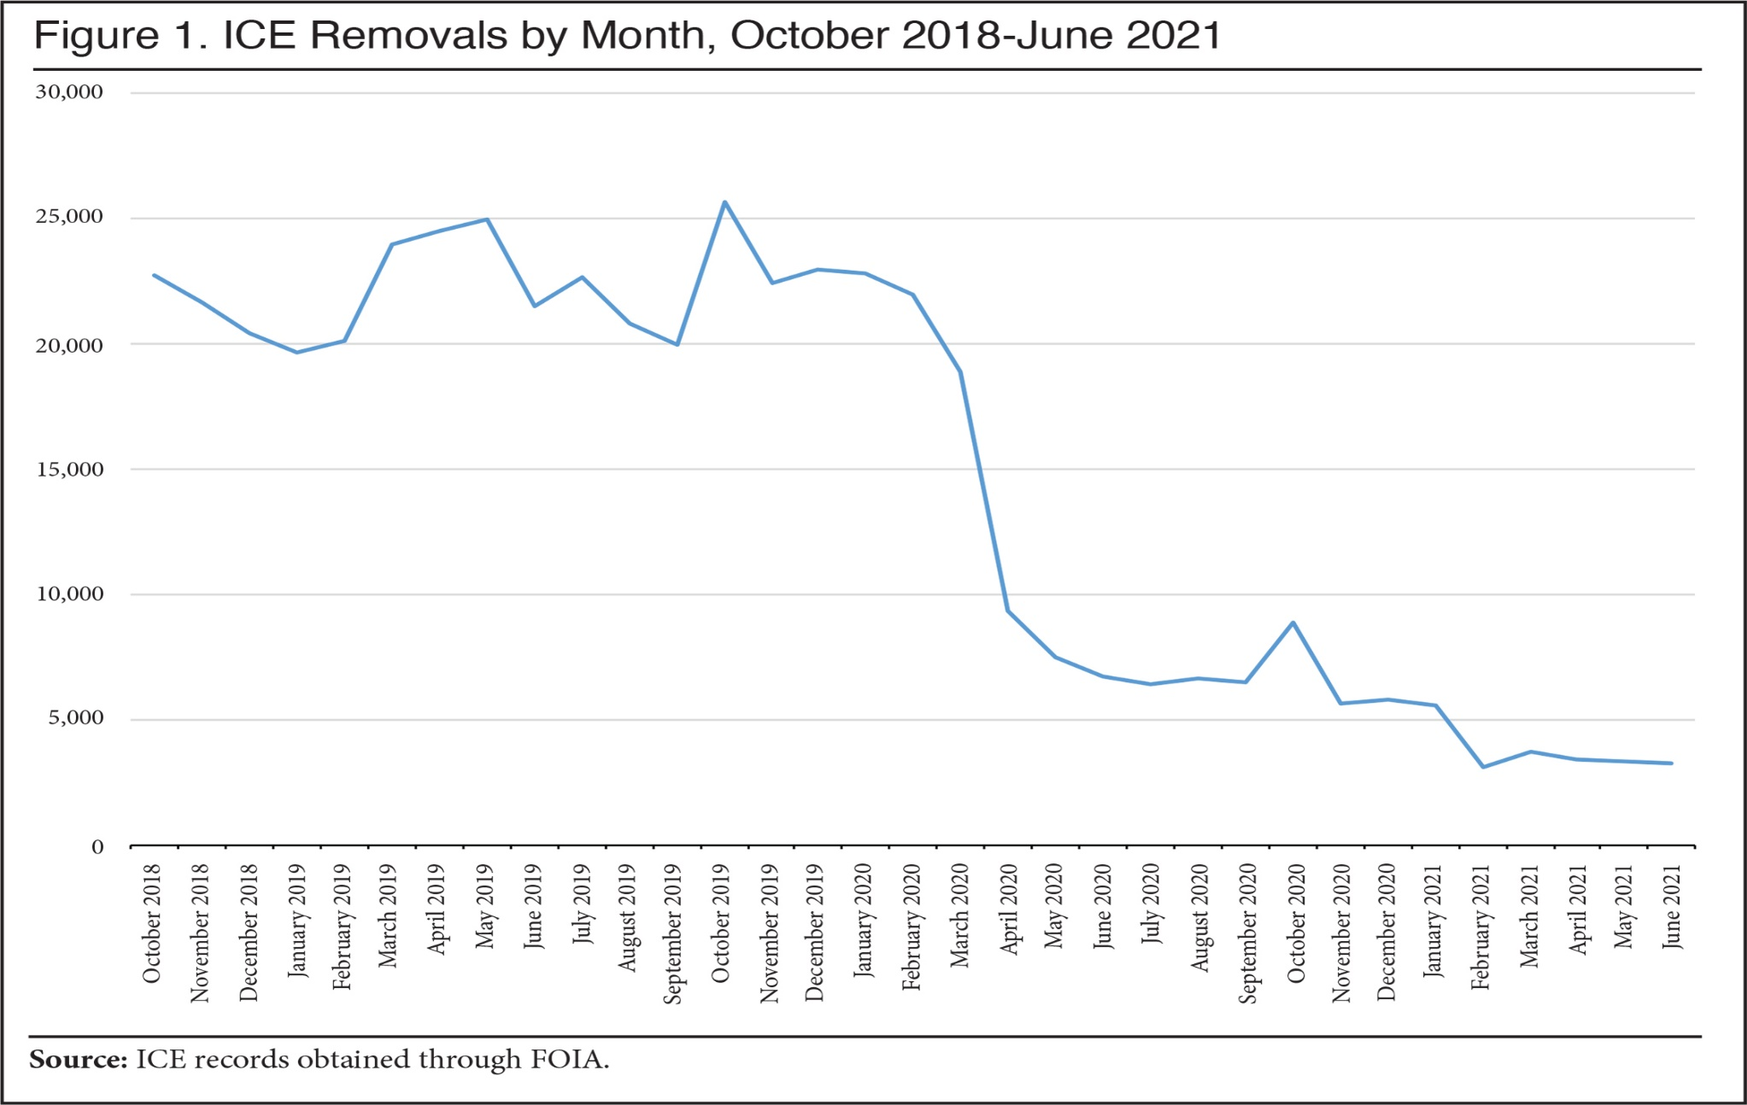

Slide 6
COLUMN
Is This Venezuelan In Metro Detroit An Asylum Seeker Or Suspected Terrorist?
Report: ICE Releases Border-Crossing Terrorist Suspect from Venezuela Despite FBI Recommendation
A Lebanon-born Venezuelan on the FBI’s terrorism watchlist due to “highly derogatory information” is free in Michigan

Slide 7
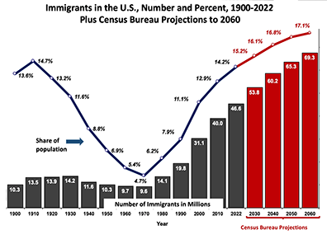
Foreign-Born Population Hits Record 46.6 Million in January 2022
Census Bureau data shows the number of immigrants in the U.S. rebounded dramatically after declining through mid-2020

